Slide 1
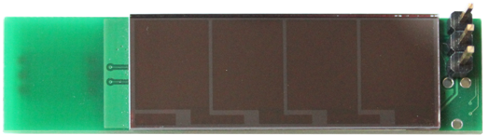
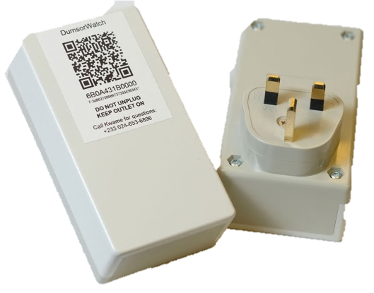
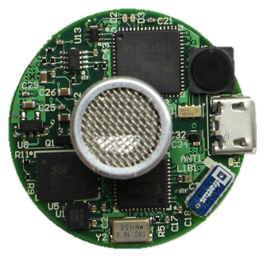
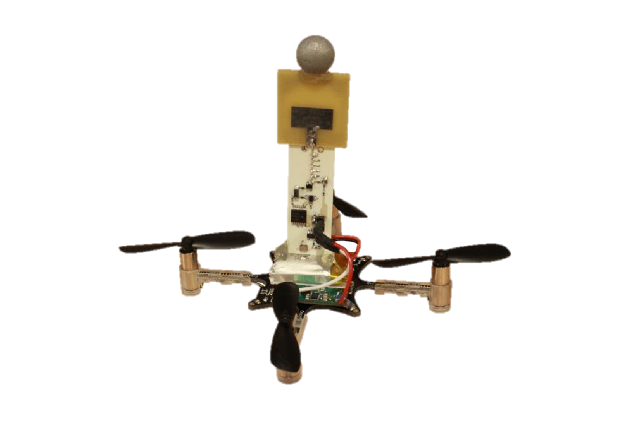
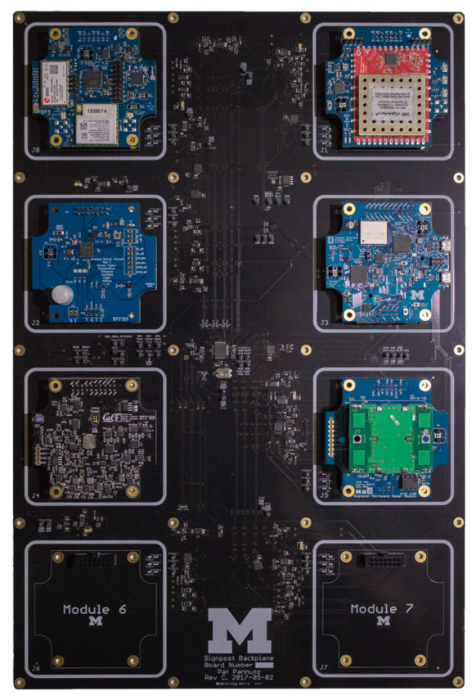
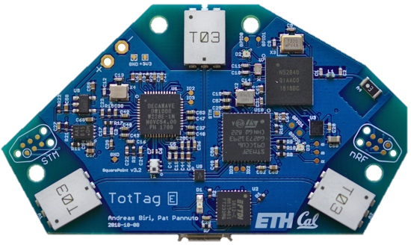
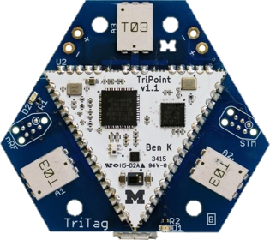

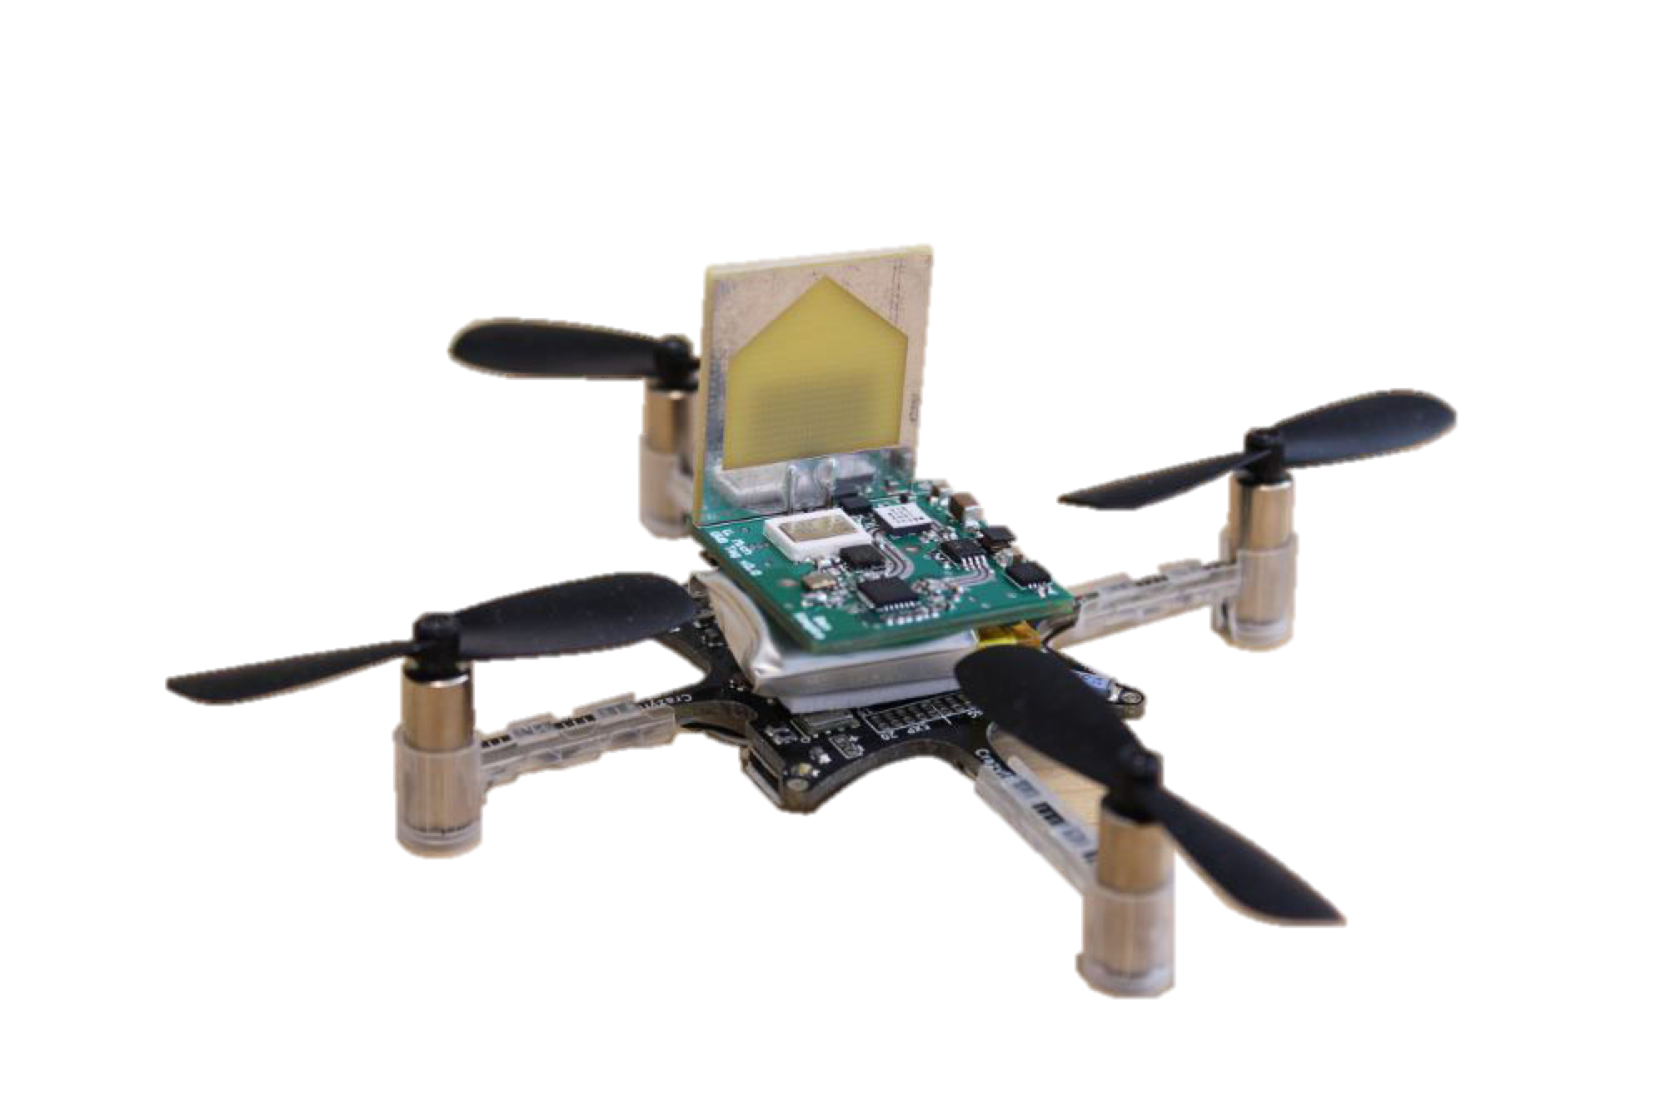

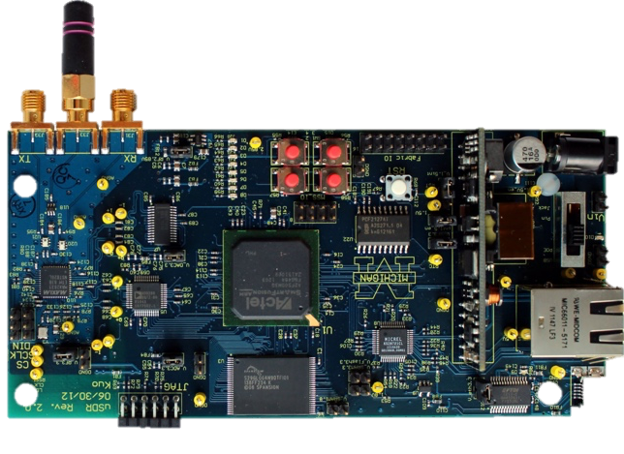
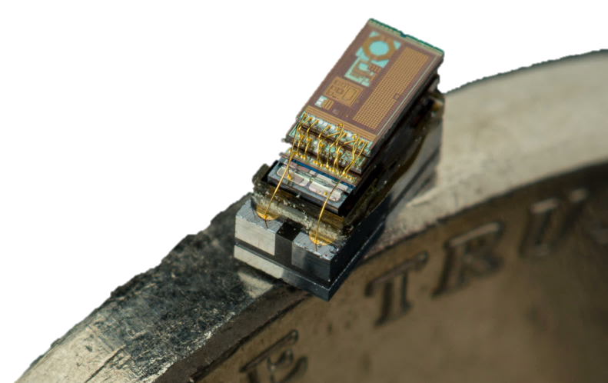
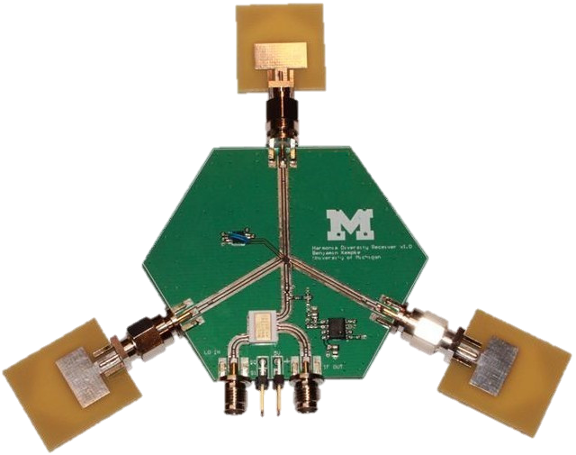

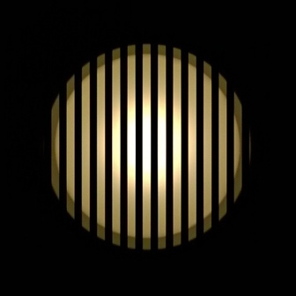
CSE 141: Introduction to Computer Architecture
Pat Pannuto, UC San Diego
ppannuto@ucsd.edu
Human Perception
Camera Perception

Slide 2
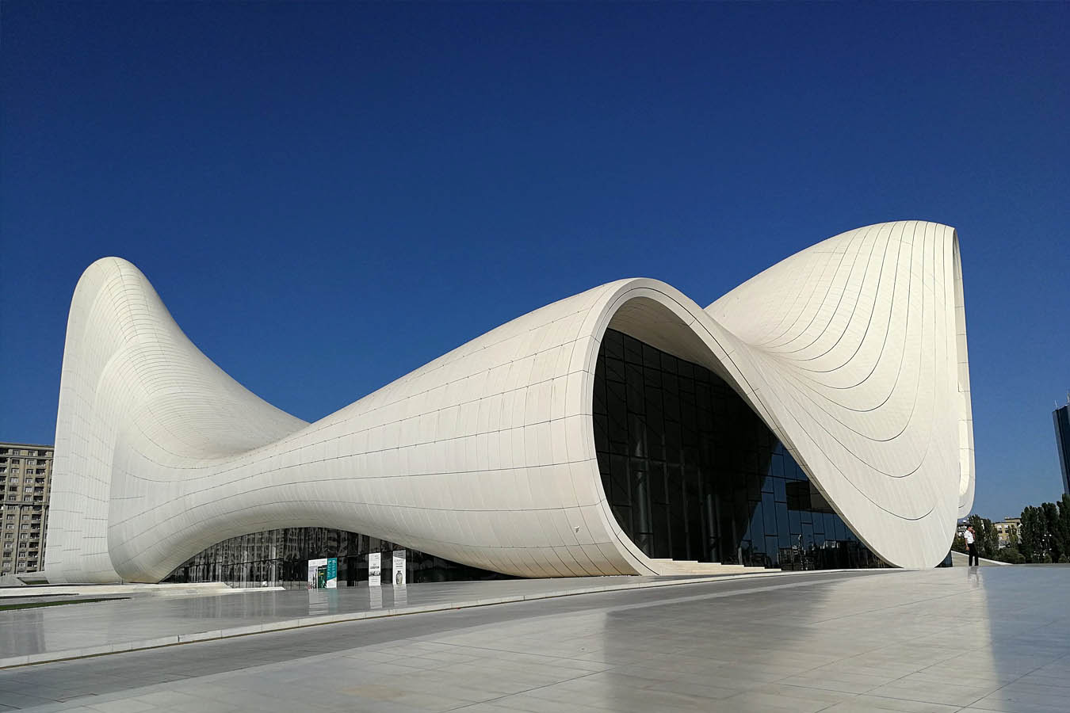
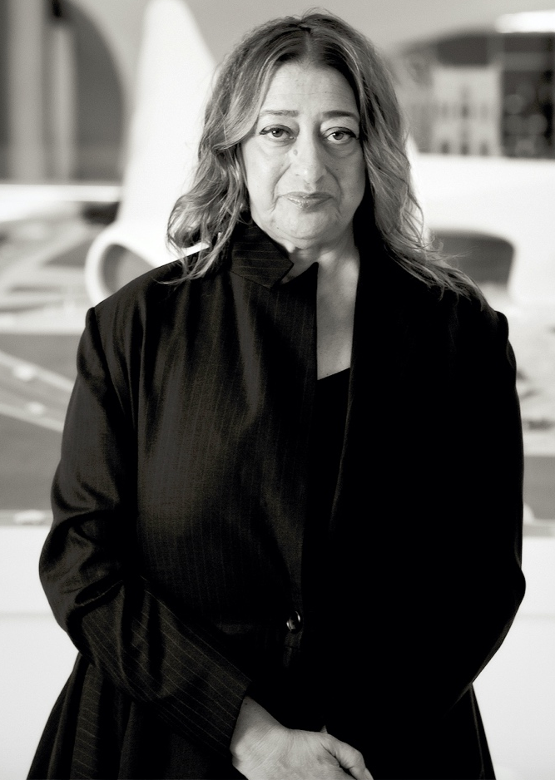
What is Computer Architecture and where does it fit in Computer (Science) Engineering?
One view: what is an Architect and how do they fit in the creation of buildings?
Zaha Hadid
Port Authority Building in Antwerp, designed by Zaha
Graphics courtesy Wikipedia
Notes:
Idea: architects responsible for the design, pulling all the pieces together, high-level vision

Slide 3
Computer science is all about abstractions
Applications
Programming Language / Runtime
The person who designs this…
Operating System
…only needs to worry about these
Processor
Computational Units
Digital Logic / Circuits
Physical Layout (VLSI)
But who designs the big picture?
Chip Fabrication

Slide 4
Computer architects look at the system as a whole and design abstractions
Applications
Programming Language / Runtime
Operating System
Instruction Set Architecture
Processor
CSE 141
Machine Organization
Computational Units
Arithmetic & Number Systems
Digital Logic / Circuits
Physical Layout (VLSI)
Chip Fabrication
Notes:
Idea, the orange boxes exist as layers because architects described how to effectively decompose systems
-- echo and amplify H&P’s tenet: “Use Abstractions to Simplify Design”
This class focuses on the classic foundations of arch: [top-down] how does software talk to hardware, [bottom-up] how to turn digital logic into computable elements, [put it together] how to best put these pieces together

Slide 5
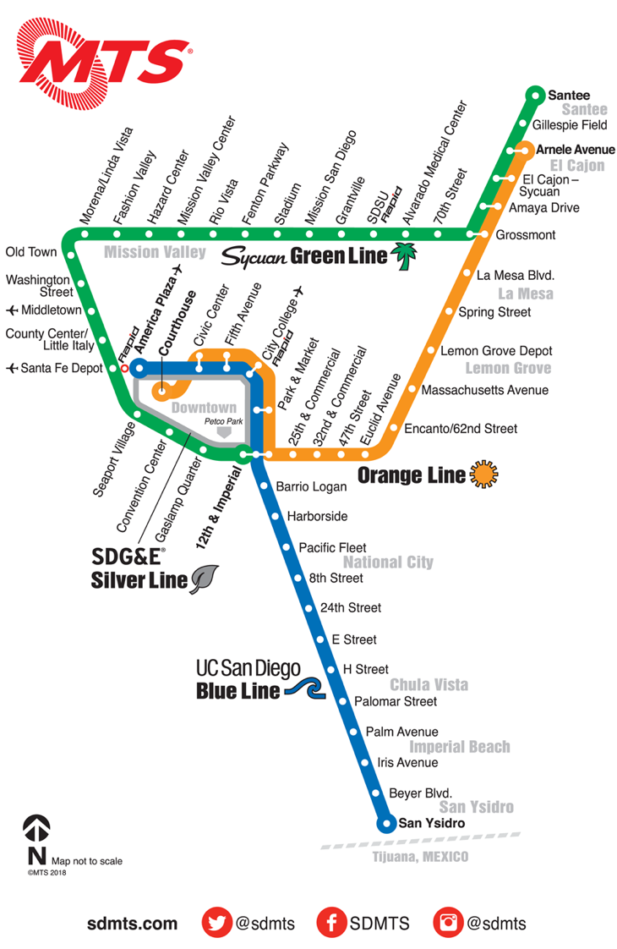
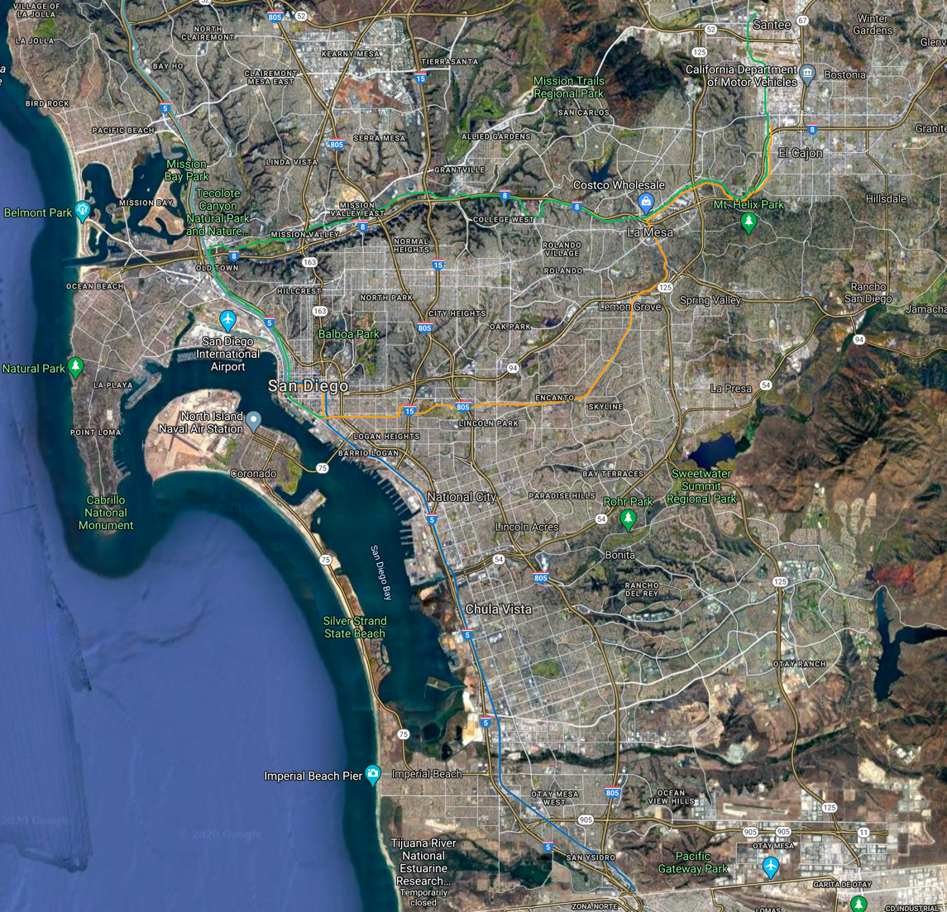
Good abstractions make it easier to focus on reasoning about one part of a large, complex system
Which of these maps is easier to use to plan a trolley trip?
Notes:
What is an abstraction?

Slide 6
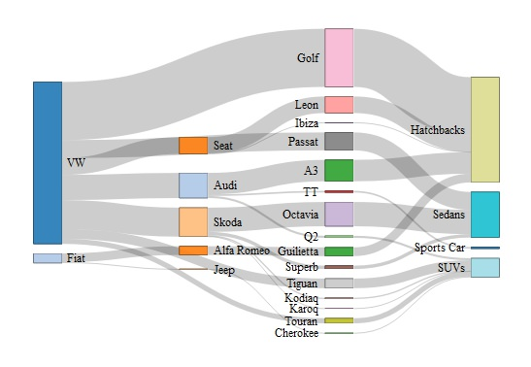
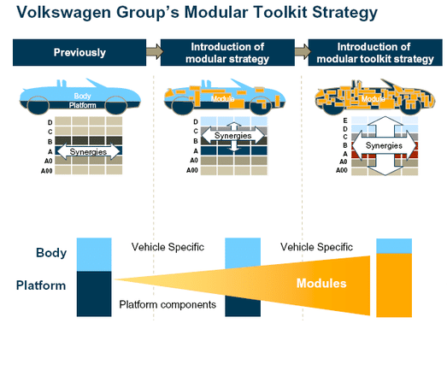
Good abstractions make it easier to focus on reasoning about one part of a large, complex system
Modularization is fundamental to design in many domains
Modular Car Body Design and Optimization by an Implicit Parameterization Technique via SFE CONCEPT
Fabien Duddeck, Hans Zimmer
https://www.reddit.com/r/dataisbeautiful/comments/8m15g9/automobile_platform_sharing_work_in_progress/
Notes:
What is an abstraction?

Slide 7
But what if I’m not going to become a computer architect?
If I only want to build these…
Applications
Programming Language / Runtime
Operating System
Processor
…why do I need to know
about any of this?
Computational Units
Digital Logic / Circuits
Physical Layout (VLSI)
Chip Fabrication

Slide 8
The real world is full of leaky abstractions
Goal: Sum up all the entries of a two dimensional array
Which of these implementations is faster?
int twoDarray[256][256];
int sum = 0;
for (int i=0; i<256; i++) {
for (int j=0; j<256; j++) {
sum += twoDarray[i][j];
}
}
int twoDarray[256][256];
int sum = 0;
for (int i=0; i<256; i++) {
for (int j=0; j<256; j++) {
sum += twoDarray[j][i];
}
}
Answer: “It depends”

Slide 9

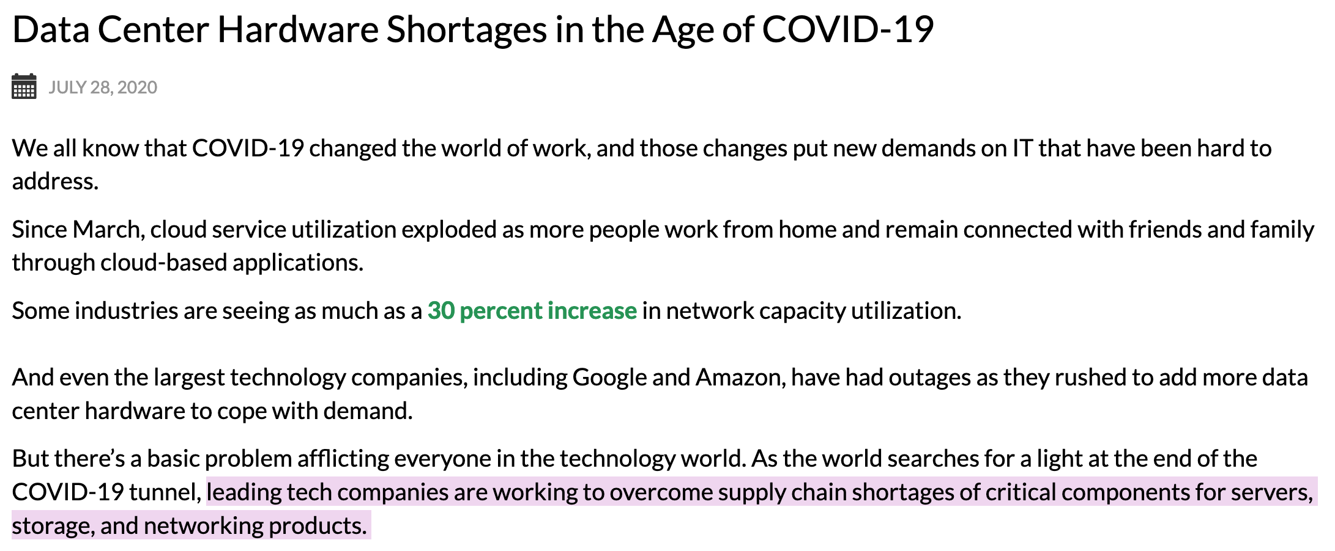
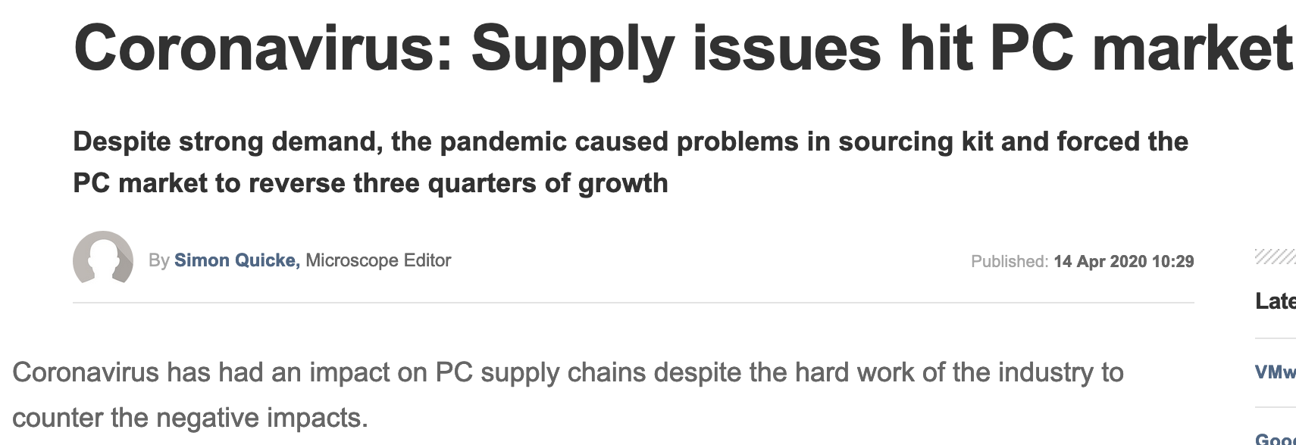
Architects look across systems to find and improve inefficiencies – always valuable, sometimes critical…
What happens when workload changes overnight, and there’s no way to buy your way out of the problem?
Architects help to fix it

Slide 10
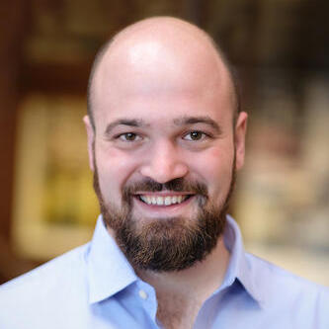
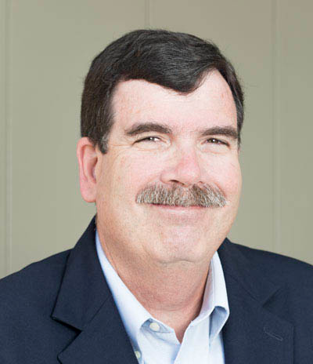
Course Administrivia
Instructors
Sec A00: Pat Pannuto
Sec B00: Dean Tullsen
The sections will run “in sync”
We will have shared assignments, shared exams
The lectures will cover the same content but in different ways
You may watch either lecture (or both!)
If something I say is confusing, maybe watching Dean will help (or vice-versa)

Slide 11
Course Staff
Four amazing TAs:
Kazem Taram
Nitish Kulshrestha
Shanti Modi
Sumiran Shubhi

Slide 12
Assessments & Workload
Grading
Participation: 10%
Weekly participation quizzes of lecture material (10 weeks -> 1% / quiz!)
Homework: 15%
Midterm: 30%
Final Exam: 45%
(Inclusive final)
Our assigned final exam slot is SATURDAY, December 12 — Plan for this now!
Workload
Academic Integrity

Slide 13
Active engagement is key to effective learning
Watching videos is not a passive activity
Write down questions about what you do not understand!
Use checkpoints effectively
Watching (or reading) 5 minutes before class is better than not at all, but 5+ hours before is much better
Lectures, office hours, and exercises are not passive activities
Work through examples and ask the questions you have
Homework is designed to help you solidify your understanding
Study for tests “honestly to yourself” – you must engage with questions

Slide 14
And then some modern highlights from here at ucsd
We’ll take a 3-5 minute break here…

Slide 15
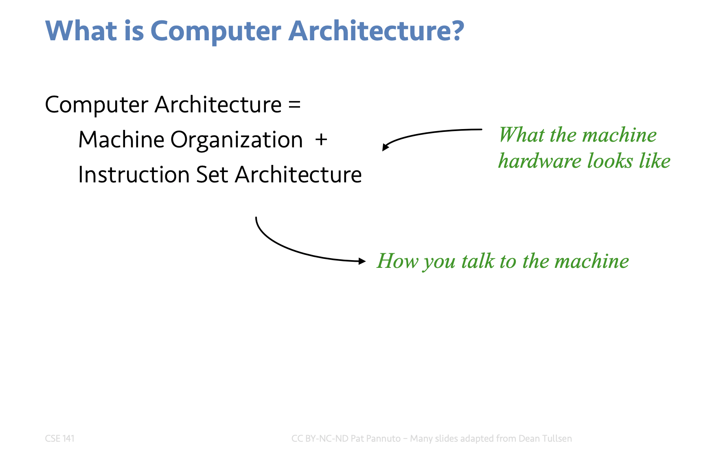
This class will build up architecture from the fundamentals
Video 1, Slide 1:

Slide 16
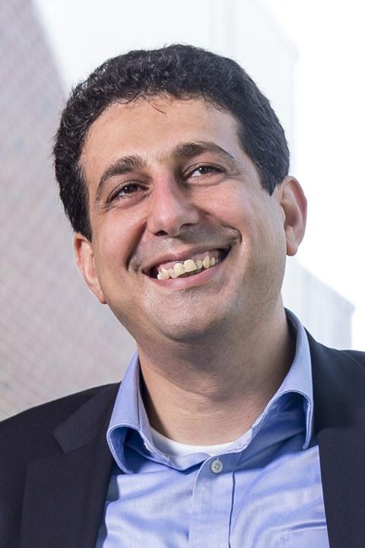
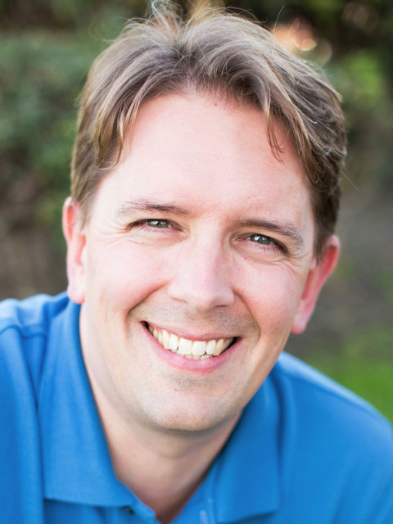

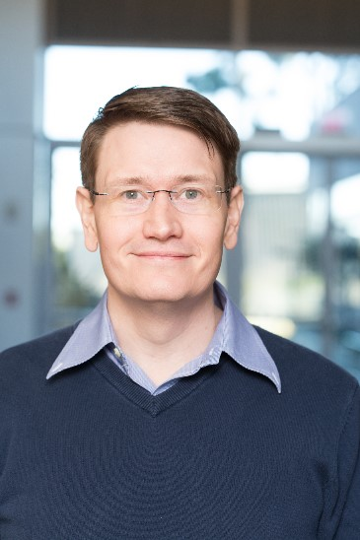
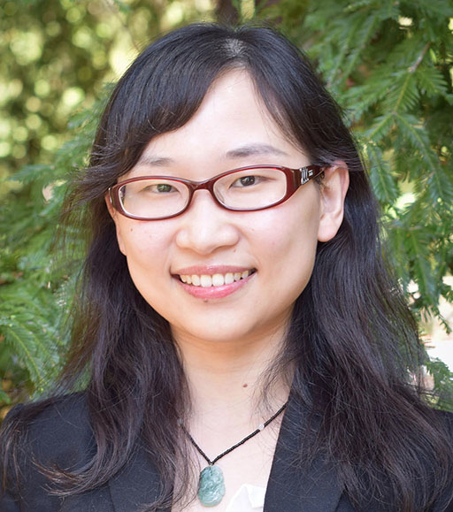
But for the rest of today, I want to highlight the kinds of cool stuff that architects do
UCSD has an amazing team of architecture faculty

Slide 17
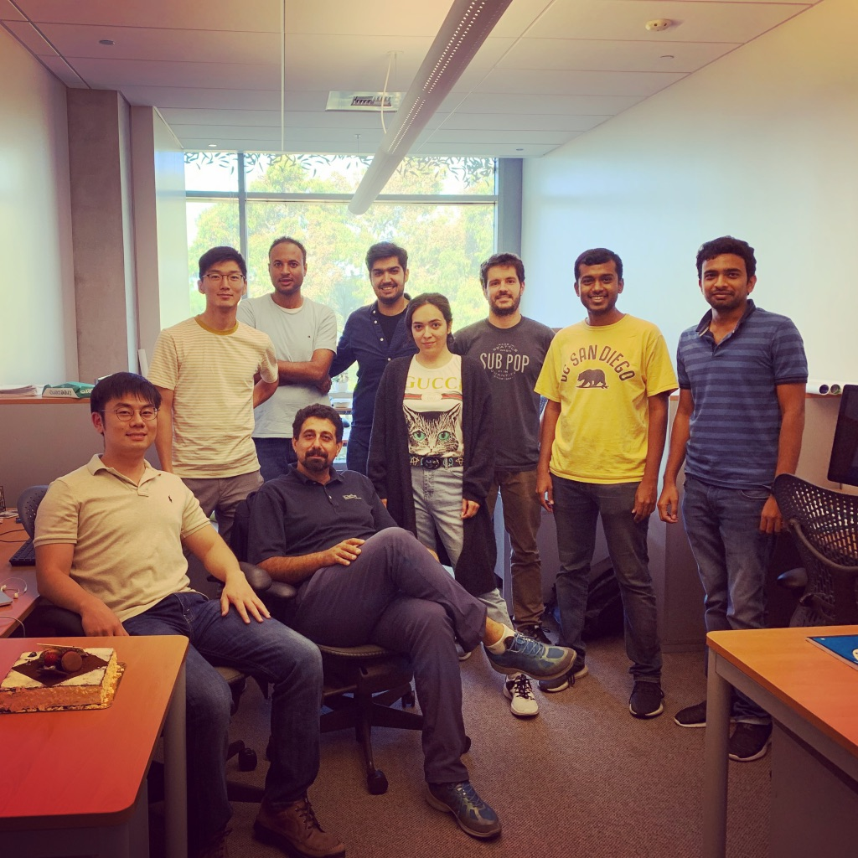
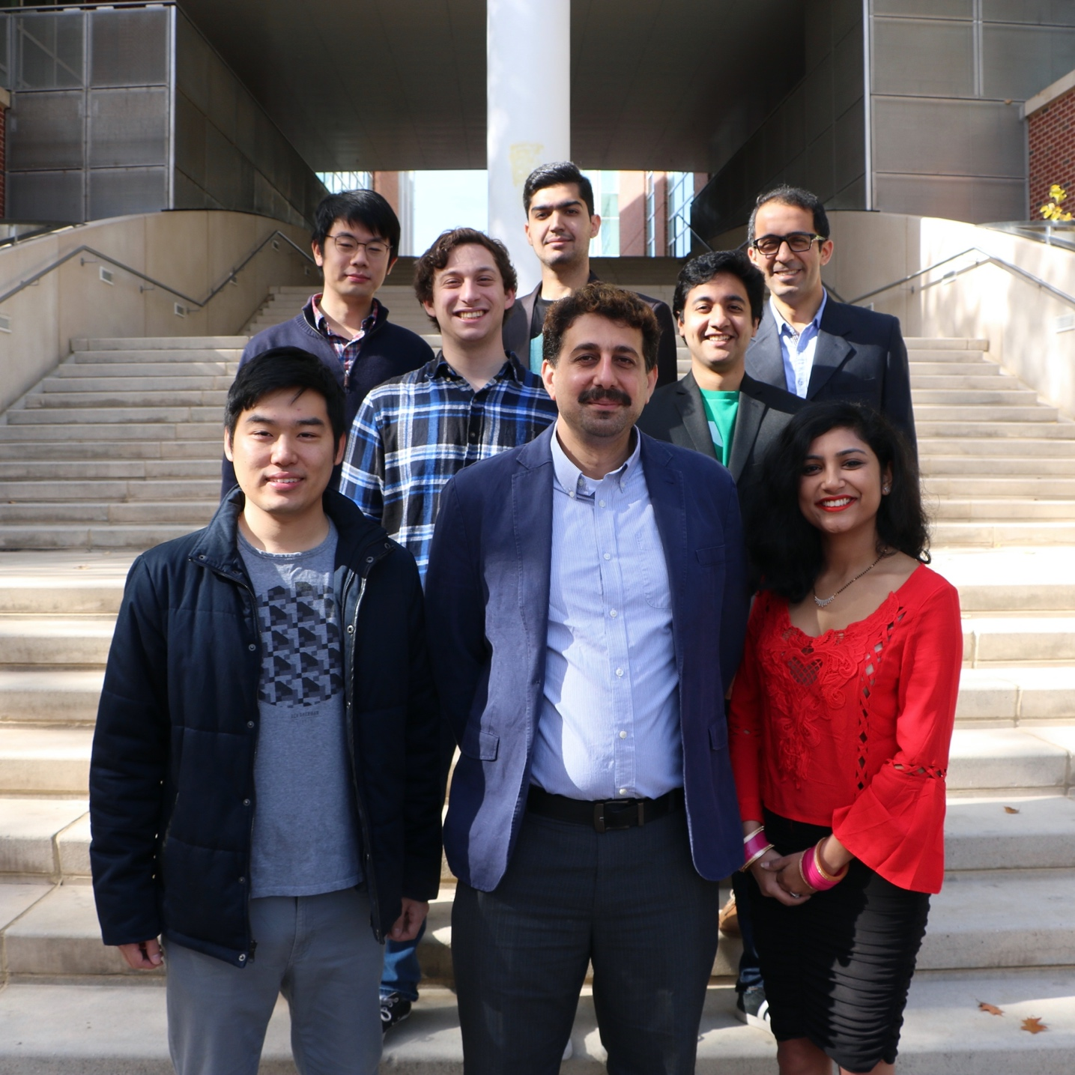

Slide 18
Notes:
“Alternative Computing Technologies”
Look at how ideas are inter-related; approx. comp will evolve from

Slide 19
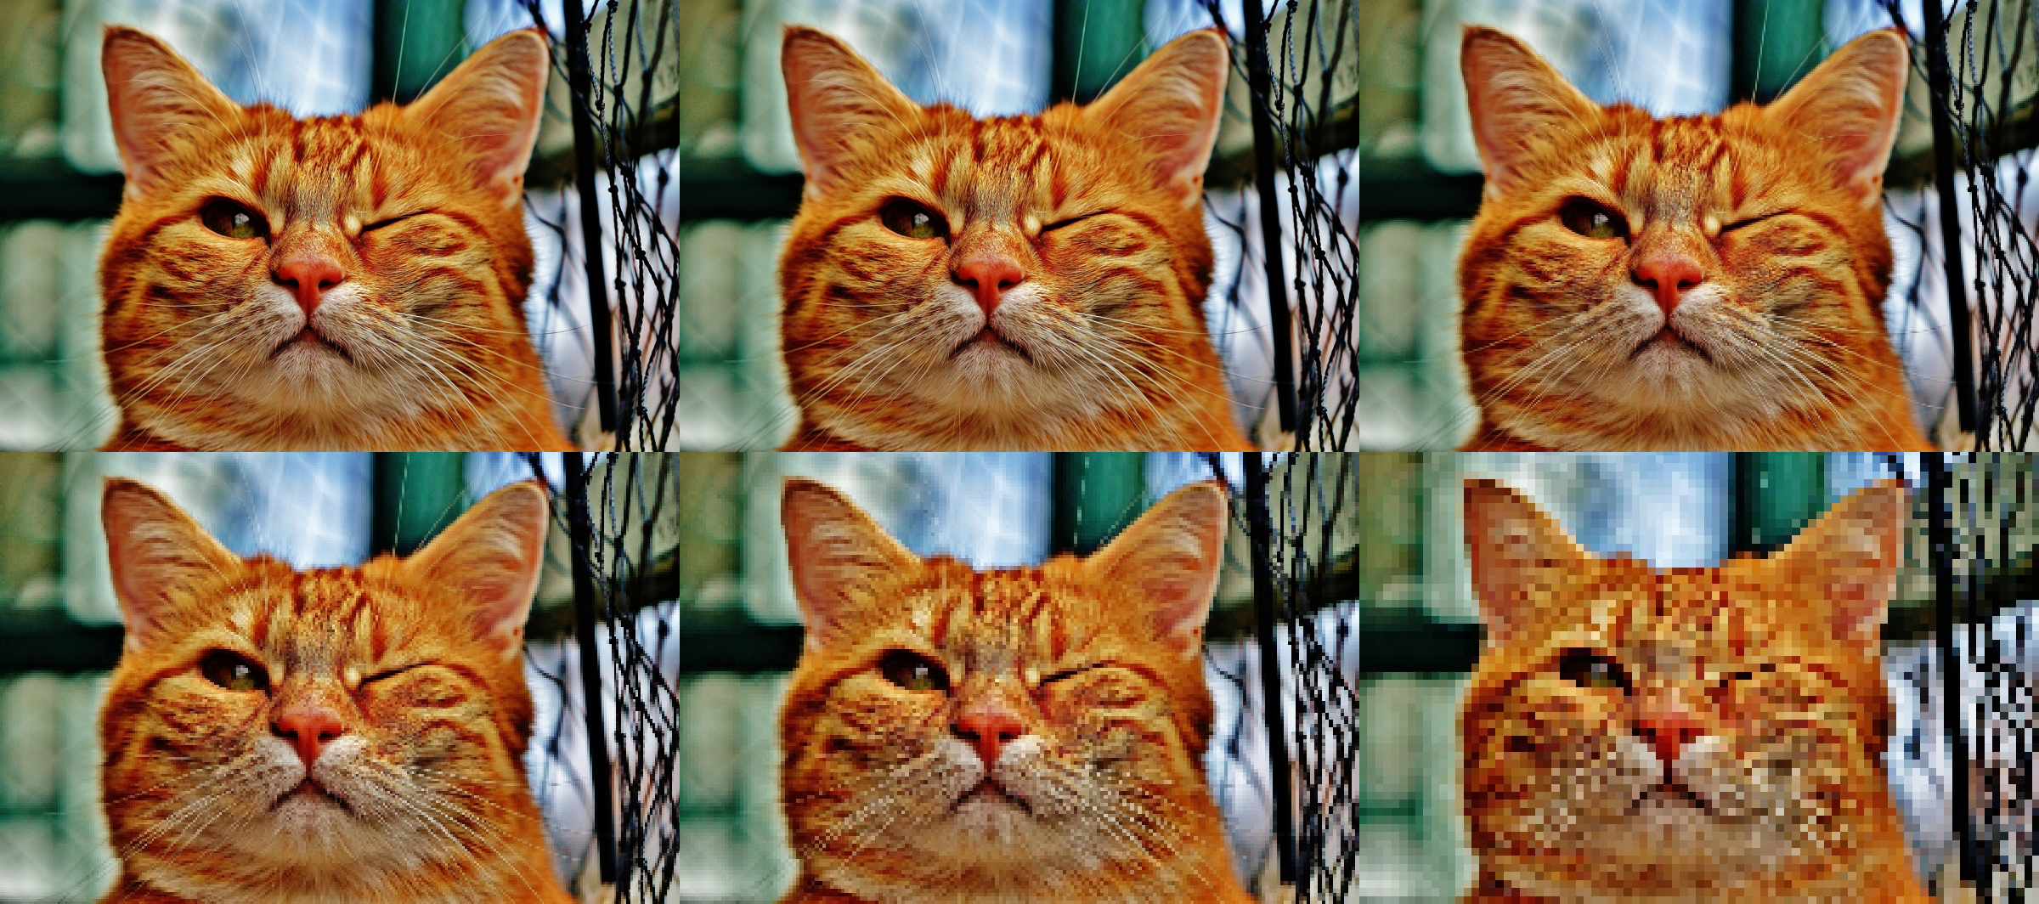
One wild idea: “Approximate Computing”
Aka, what if 1 + 1 doesn’t always equal exactly 2?

Slide 20

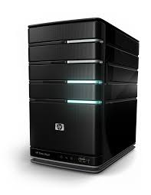

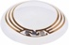
Embracing imprecision allows for major gains in performance and energy
Data center
Desktop
Mobile
IoT
Imprecision

Slide 21
A cross-stack approach to enable approximation
Techniques
Quality Control
End-users
AXGAMES
[ASPLOS’16]
Apps
AXBENCH
[IEEE D&T’16]
NPU
[MICRO‘12]
ANPU
[ISCA‘14]
SNNAP
[HPCA’15]
NGPU
[MICRO’15]
AxRAM
[PACT’18]
Language
FLEXJAVA
[FSE‘15]
Compiler
RFVP
[PACT’14, IEEE D&T’15, ACM TACO’16, HiPEAC’16]
MITHRA
[ISCA’16]
Arch
TRUFFLE
[ASPLOS‘12]
Microarch
Circuit
GRATER
[DATE’16]
AXILOG
[DATE’15, IEEE Micro’15]
Devices

Slide 22
Privacy Preserving Techniques for Inference
Privacy
Shredder
Homomorphic Encryption
Accuracy-Agnostic
Noise Addition
Accuracy Loss
Computation Cost
Notes:
Conceptually, if we want to achieve higher privacy on a pretrained model using noise naively, we would incur huge amounts of accuracy loss. Another method to achieve privacy for inference is HE, which is extremely compute intensive and Adds computing overhead to both server- and edge-sides. This is particularly concerning for the edge devices that are resource constrained.
We propose shredder, which learns noise distributions that are tolerated by the network and do not harm accuracy, while decreasing the amount of excessive information in the input.

Slide 23
Execution Model
Previously Trained Noise Distributions
+
Sent to the Cloud
Notes:
Our execution model consists of splitting the neural network into 2 parts, and executing the first part on the edge device, and the second more compute intensive part on the cloud. To increase the privacy of the edge device, we add our randomly generated calibrated noise to the output of the edge partiontion, which obfuscate the excessive information, while maintaining the accuracy.

Slide 24
Rethinking the abstractions
Algorithms
Programming Language
Efficiency
Performance
Compiler
Architecutre
Microarchitecture
Cost
Cost
Precision
Generality
Circuit
Physical Device

Slide 25
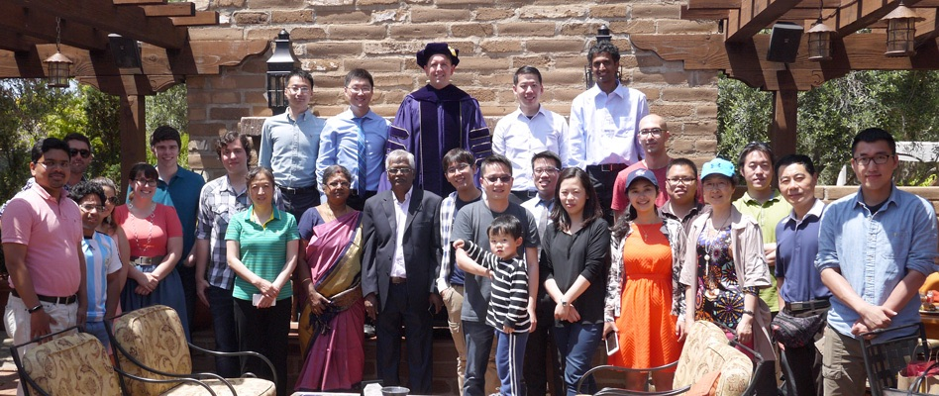
Memory, Storage, Software, and Architecture in the NVSL

Slide 26
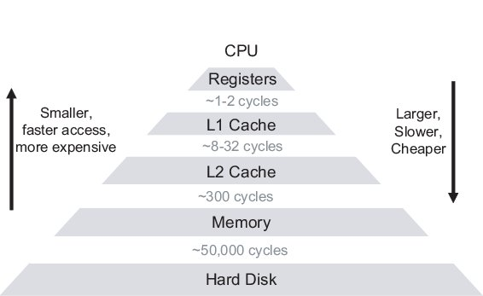
This is a slide you will encounter in many CE/CSE classes…
Non-Volatile Memory
Chellappa, Srinivas & Franchetti, Franz & Püschel, Markus. (2007). How to Write Fast Numerical Code: A Small Introduction.
Notes:
Traditional data hierarchy
NVM messes with this because it’s almost as bit has hard drives but as fast as main memory – how does that change the rest of the computing system?

Slide 27

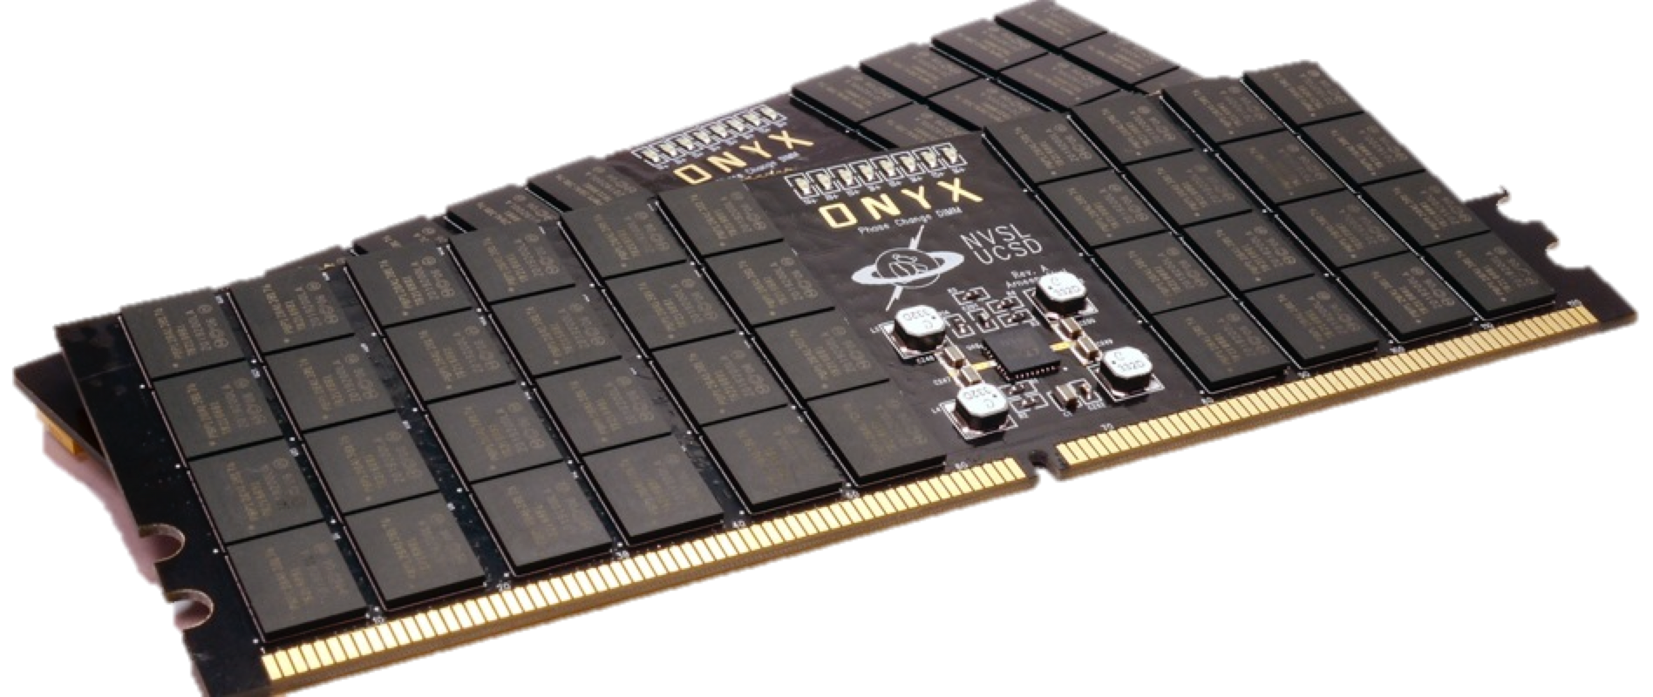
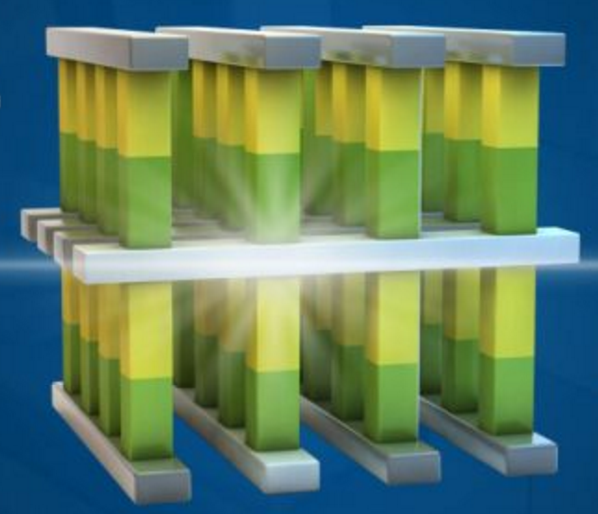
Applications
NV-Heaps
Pangolin
MARS
Pronto
Willow
Tools
Libraries
Languages
NOVA
Orion
Ziggurat
SubZero
Operating Systems
Distributed Systems
Moneta
QuickSAN
Hardware

Slide 28
NVSL Students Lead Industry
We Built
Opt. SSD interface (2009)
Direct, remote SSD (2013)
First PCM SSD (2011)
PMEM prog. tools (2011)
Industry Built
NVMe (2011)
NVMe over Fabrics (2016)
Optane (2016)
PMDK (~2014)

Slide 29


Mobilizing the Micro-Ops: Exploiting Context Sensitive Decoding for Security and Energy Efficiency

Slide 30
Leaky abstractions are not always just performance problems…
This loop behaved differently because of how caches work
Architects added “hidden” caches: faster, intermediate memories

Slide 31

Leaky abstractions can be security threats!
Notes:
When things behave differently (that should not have) on shared machines (i.e. the cloud) – you can steal data!

Slide 32
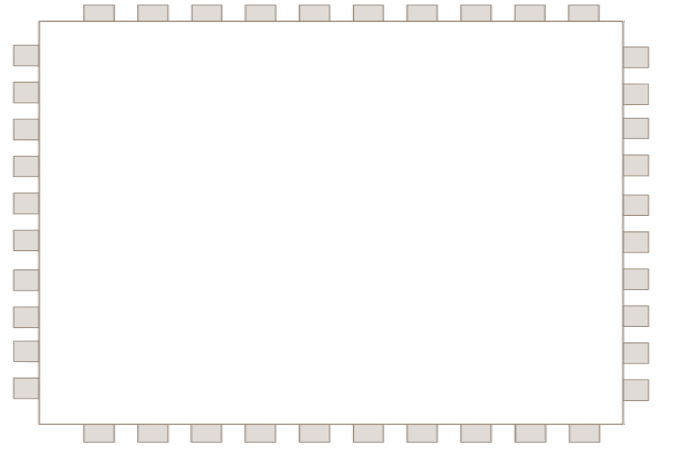
Mobilizing the Micro-Ops Exploiting Translated ISAs
Fetch
WB
Instruction Decoder
Rename
Execute
5
Notes:
This is a simple pipeline, which is at the heart of every processor; we’ll learn about this in class

Slide 33
Mobilizing the Micro-Ops Exploiting Translated ISAs
Fetch
WB
Instruction Decoder
Native Instructions (e.g., inc [0x803ac] )
Rename
Execute
5

Slide 34
Mobilizing the Micro-Ops Exploiting Translated ISAs
Fetch
Instruction Decoder
Rename
Execute
WB
ld t0, [0x803ac]
Native Instructions (e.g., inc [0x803ac] )
add, t0, t0, 1
st [0x803ac], t0
5

Slide 35
Mobilizing the Micro-Ops Exploiting Translated ISAs
Fetch
Instruction Decoder
Rename
Execute
WB
ld t0, [0x803ac]
security_check1
Native Instructions (e.g., inc [0x803ac] )
add, t0, t0, 1
security_check2
st [0x803ac], t0
5

Slide 36
Context Sensitive Decoding fixes a leaky abstraction
Eliminating cache side channels via cache obfuscation
Energy and Performance optimization via selective devectorization
ISCA 2018
IEEE Micro Top Picks in Computer Architecture
Spectre mitigation via targeted insertion of fence micro-ops (Context Sensitive Fencing)
ASPLOS 2019
Notes:
Hadi and Steve examples were architecture that makes changes across the whole stack
Dean example makes changes at a very targeted point to make promises across the stack hold true again

Slide 37
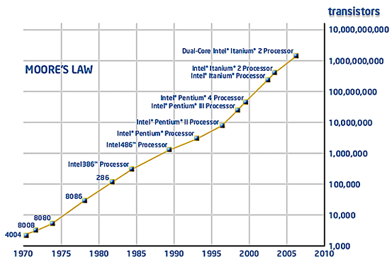
Performance was king, until we unplugged computers
A lot of architecture research is about making sure graphs continue to go up and to the right

Slide 38
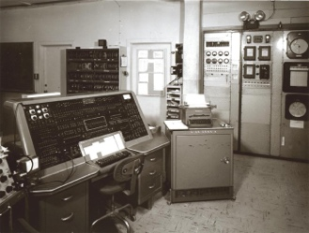
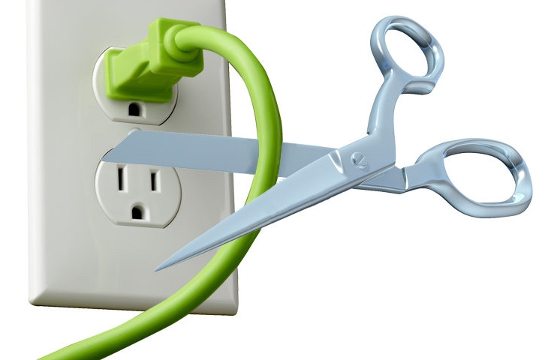
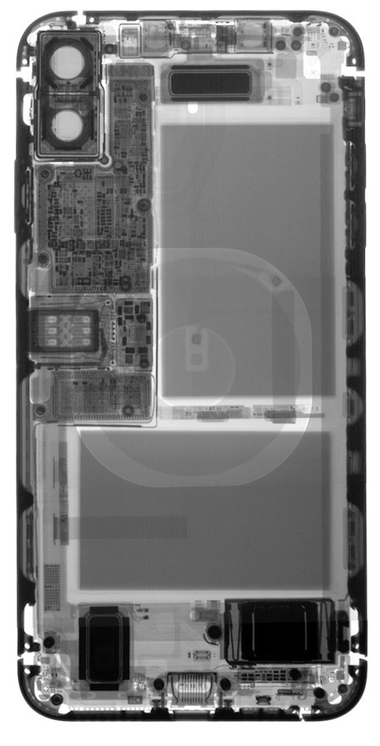
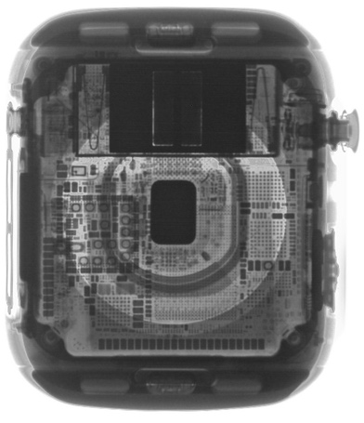
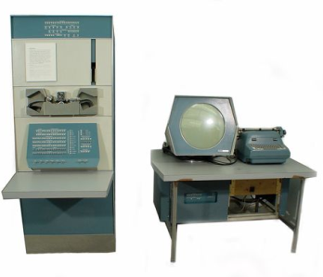
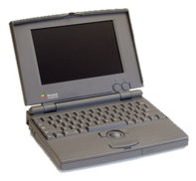
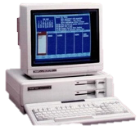
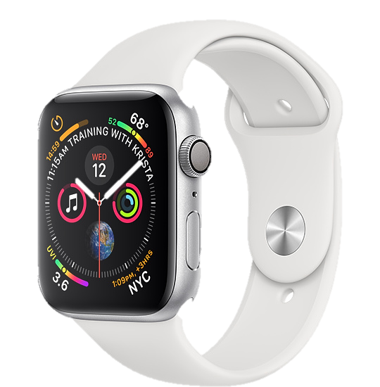

I spend my time on graphs that go down and to the right
With the laptop class, computing “cut the cord” and energy (battery life) became a first-class concern
Mainframe
Computer
Workstation
By volume, the emerging computing classes are mostly energy storage
Volume is shrinking cubically
Laptop
Mini Computer
Battery
IoT/Wearable
Personal Computer
Smartphone
Notes:
Defining feature of modern computing classes is the amount of energy storage required to allow their operation
Clip art: http://www.ctecsolar.com/cut-cord-electric-company/
X-rays: iFixit teardowns

Slide 39
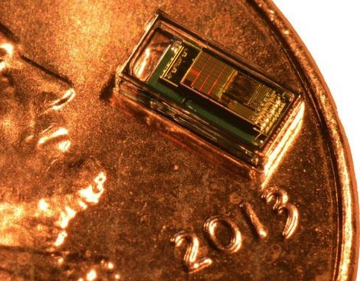
Computational platforms will continue to scale
Mainframe
Workstation
The next generation of computing will only be a cubic millimeter in size
Millimeter-scale batteries have capacities around 5 µAh
(would power an idle iPhone for 0.6 s)
Laptop
Mini Computer
IoT/Wearable
Personal Computer
Smartphone
“Smart Dust”
Notes:
Clip art: http://www.ctecsolar.com/cut-cord-electric-company/
X-rays: iFixit teardowns
Watch: 291.8e-3 / 5e-6 = 58360
Phone: 2659e-3 / 5e-6 = 531800
Not the greatest paper, but maybe a reasonable estimate of actual power draw of iphone 5s: https://arxiv.org/pdf/1606.05576.pdf
1560 mAh / 51.27h = 0.0305 A
(.005 mAh) / (0.03046875 amperes) = 0.590769231 seconds

Slide 40
Energy constraints will play a central role in the evolution of computing platforms
Mainframe
Workstation
Laptop
How must traditional paradigms change, adapt, or re-invent for the new computing classes?
Mini Computer
IoT/Wearable
Personal Computer
Smartphone
“Smart Dust”
Notes:
Clip art: http://www.ctecsolar.com/cut-cord-electric-company/
X-rays: iFixit teardowns
Watch: 291.8e-3 / 5e-6 = 58360
Phone: 2659e-3 / 5e-6 = 531800

Slide 41
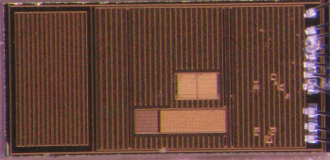
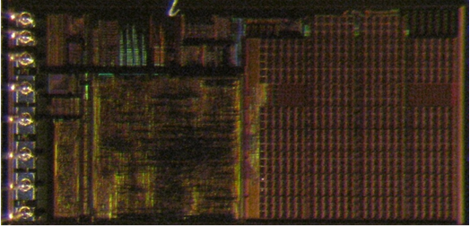
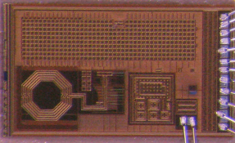


One of the first challenges was re-thinking how we put together computers
Temperature Sensor
~10 pW standby, < 1 µW active
CPU
~1 nW standby, ~5 µW active
?
Radio
~10 pW standby, ~10 µW active
Energy Harvesting & Storage
1~10 nW indoors
2~10 µAh capacity

Slide 42










MBus enabled the of development of dozens of millimeter-scale motes as part of the Michigan Micro Mote (M3) project

Slide 43

Check out the “World’s Smallest Computer” exhibit at Silicon Valley’s Computer History Museum!

